Slide 1
Introduction to Data Science Data Mining for Business Analytics
Brian d’Alessandro
VP – Data Science, Dstillery
Adjunct Professor, NYU
Fall 2014
Fine Print: these slides are, and always will be a work in progress. The material presented herein is original, inspired, or borrowed from others’ work. Where possible, attribution and acknowledgement will be made to content’s original source. Do not distribute, except for as needed as a pedagogical tool in the subject of Data Science.
Notes:
https://www.youtube.com/watch?v=aMDe5pODkB0 (harlan harris)

Slide 2
Feature selection
Notes:
The goal of finding structure is to information from one source to reduce uncertainty about another source.
What does this mean? Conditional distribution example. I.e., carnival guy who guesses your weight. If I can see your height I can reduce uncertainty about weight.
Find some height/weight data.
Under supervised exploration:
How can we (automatically) obtain a selection of the more informative variables with respect to predicting the value of the target variable?
Even better, can we obtain the ranking of the variables?
Can think of importance as one that makes the target variable more pure. This leads to the notion of entropy.

Slide 3
Why do feature selection?
The primary motivation for doing feature selection is to reduce model complexity, the benefits of which are:
Lower expected model variance
Easier interpretation of models
Better scalability (both in training and deployment)

Slide 4
Common feature selection techniques
“Naïve” methods – pre-filter features based on heuristics
Best subset selection – choose the best subset of k features from p features
Stepwise selection – incrementally add/subtract features until model performance stabilizes
Dimensionality Reduction – take rank-k approximations of X
Regularization – Implicit, based on adding complexity penalties to loss function

Slide 5
Naïve subset selection
Choose top k based on a rule:
Has highest Mutual Information/Correlation with Y
Has the most coverage
Choosing k can be learned, but generally, the feature subset is not learned via model selection methods.

Slide 6
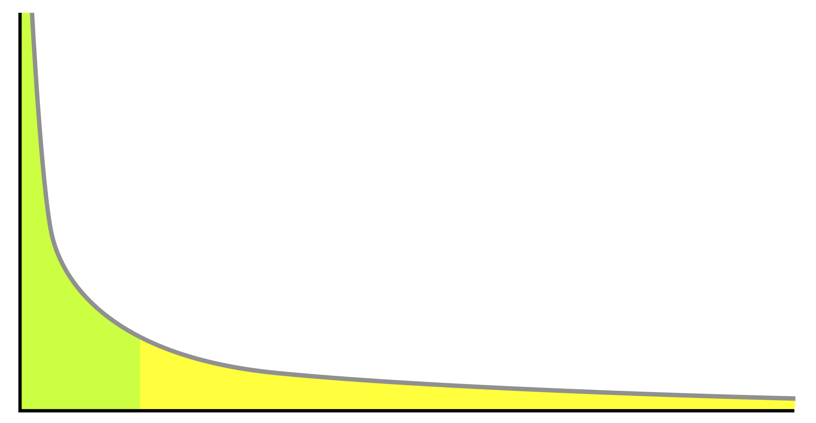
Naïve subset selection
Bag-of-words with long tail feature distributions
Some problems involve “the bag-of-words” representation. An instance can be characterized by a set of tokens U = {t₁, t₂, t₃, t₄, … t_{k}}. We often convert each token to a binary feature, where the token id is the feature name. This type of transformation often results in very high dimensional, but sparsely populated matrices.
Feature Selection: one can often build good models by just choosing the top k most populated feature (i.e, based on P(X_{i} = 1).
P(X_{i}=1)
Ordered Feature, ranked by P(X_{i}=1)

Slide 7
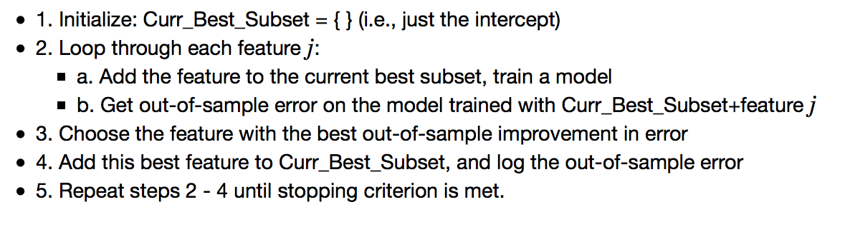
Forward stepwise selection
Forward stepwise selection is a greedy algorithm that incrementally selects kth the feature that improves the model with k-1 features the most.
Algorithm

Slide 8
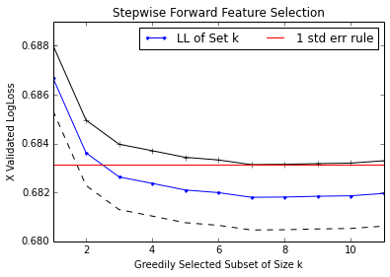
Forward stepwise selection
This plot shows the cross-validated LogLoss as we iteratively build the feature set, choosing the next best feature as the one that improves the cross-validated error the most. There are multiple ways to define a stopping criterion.

Slide 9
SVD Based feature selection
SVD can be used as a dimensionality reduction technique. Like subset methods, we choose k features, but the features are the transformed orthogonal columns of the rank-k approximation of X.
Compute rank-k SVD
X_{k}=U_{k}Σ_{k}V_{k}^{T}
X V_{k}
We can create an NxK reduced matrix with This effectively becomes our new “X” matrix, and we do any analysis (clustering, modeling, etc.) with the reduced matrix.
X’ V_{k}
We can project any new data into the reduced space by,
and then use this in our algorithms.

Slide 10
regularization
Notes:
The goal of finding structure is to information from one source to reduce uncertainty about another source.
What does this mean? Conditional distribution example. I.e., carnival guy who guesses your weight. If I can see your height I can reduce uncertainty about weight.
Find some height/weight data.
Under supervised exploration:
How can we (automatically) obtain a selection of the more informative variables with respect to predicting the value of the target variable?
Even better, can we obtain the ranking of the variables?
Can think of importance as one that makes the target variable more pure. This leads to the notion of entropy.

Slide 11
Implicit feature selection
Regularization can be thought of as an implicit feature selection tool.
We control the complexity of the model by restricted how large the feature weights can grow.
Favors more biased models as a means to reduce expected variance.
Useful when: n is small, dimensionality is high

Slide 12
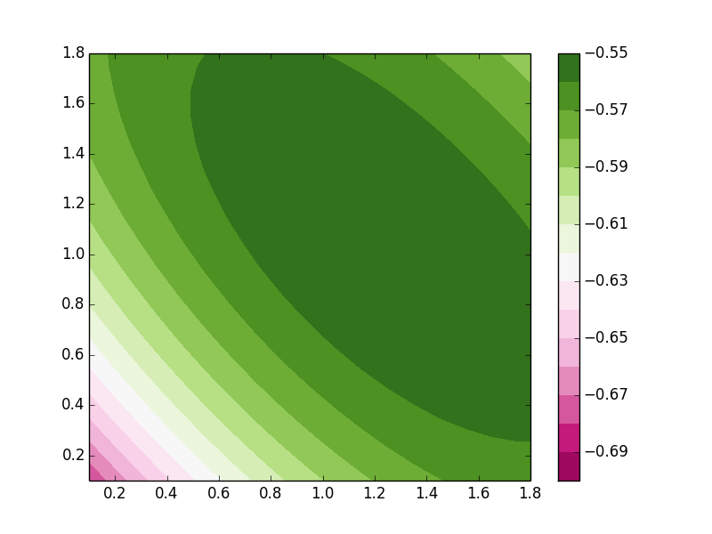

Optimization revisited
In standard ERM we look for the feature weights that minimize our loss function. We generally don’t put any limits on what values the weights can take.
Objective
Solution
W2
Use some convex optimization procedure to numerically solve.
W1

Slide 13
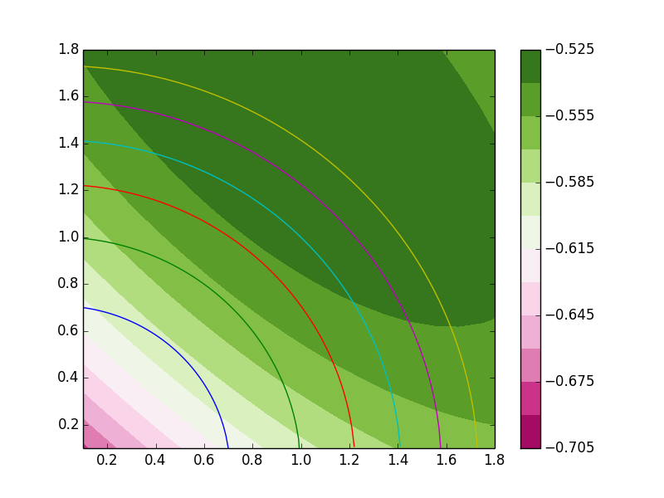
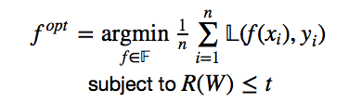
Constraining the solution
We’re going to use the same objective function, but we’re going to add a constraint. We specify that the norm of the weights can’t grow beyond a certain value. Usually R(W) is a convex function, such as L2 or L1 norm of W.
Objective
Solution
W2
Now we pick the max value that lies within the constraint circle.
W1

Slide 14
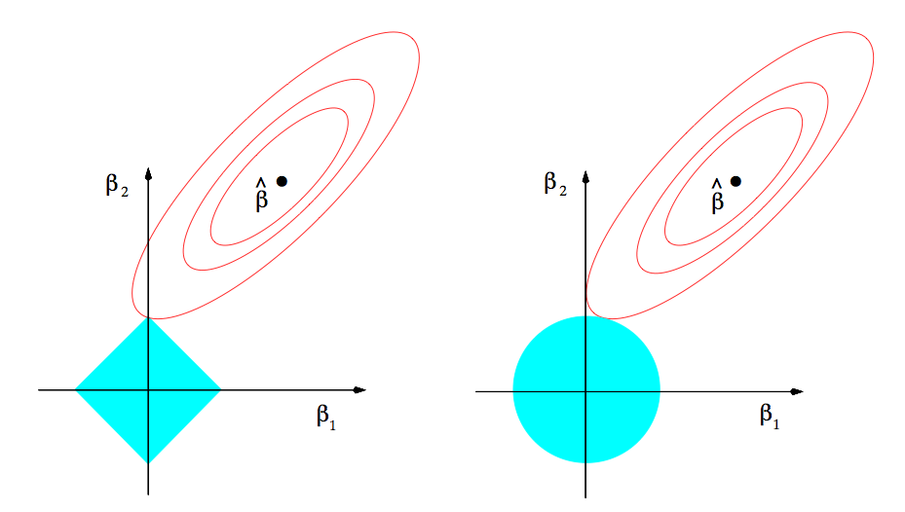
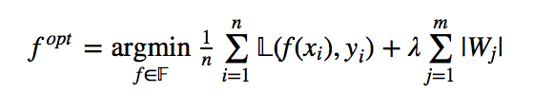
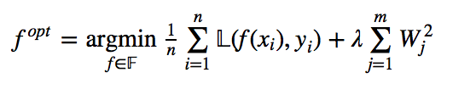
L1 and L2 regularization
We can take the Lagrange form of the constrained optimization problem, and set up two new objective functions.
L1 (Lasso)
L2 (Ridge)

Slide 15
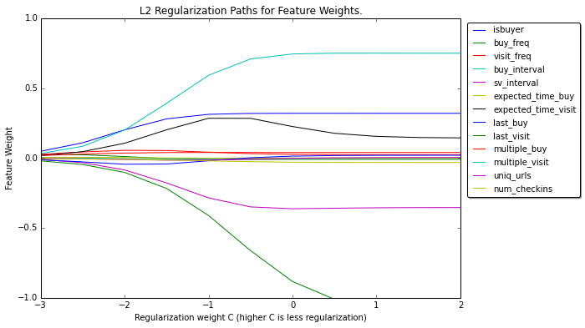
Regularization paths
We can visualize what happens to the feature weights as we change the regularization strength.

Slide 16
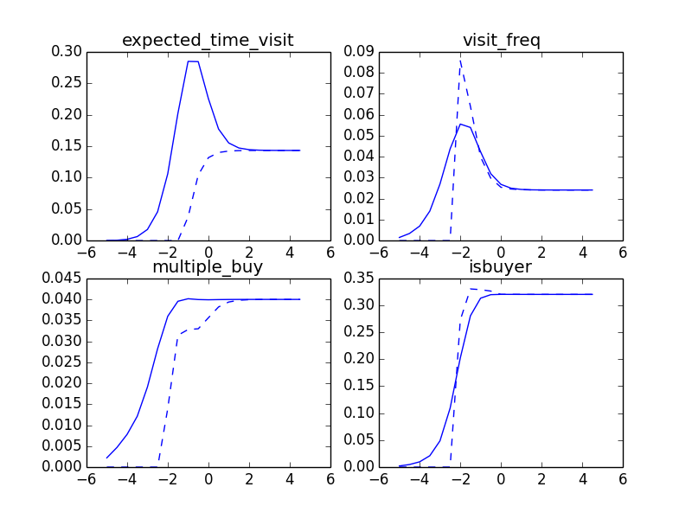
L1 vs l2 effects
Both methods constrain the size of the weights. L1 has an additional property that it holds the weight at 0 before the feature weight grows.
L1 vs L2 Paths

Slide 17
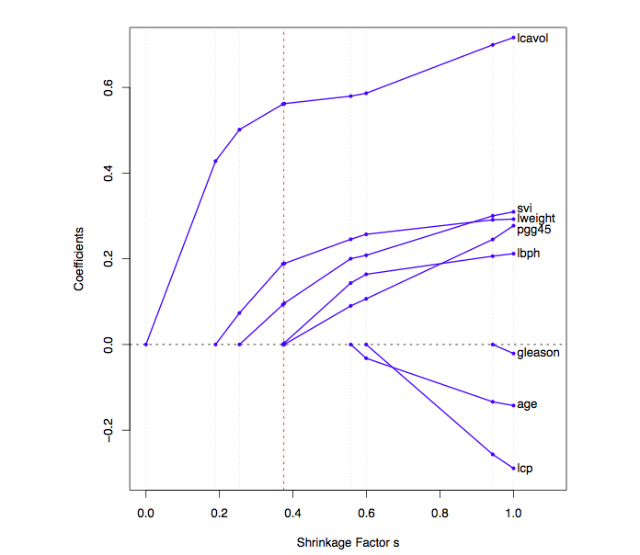
Another l1 example
This is an example from ESL, we can see here how coefficients are frozen at 0 before they grow. This is a good example of how regularization is a form of implicit feature selection.

Slide 18

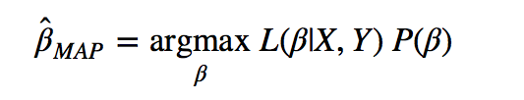
The bayesian interpretation
We can think of regularization as Maximum a Posteriori estimation problem.
Using Bayes rule, the posterior of β is:
The MAP estimate of β is the value that maximizes the posterior distribution.

Slide 19
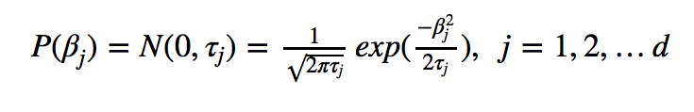
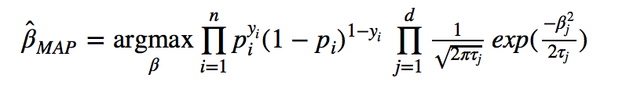
bayesian Logistic Regression
For L2 regularization, we assume that P(β) is drawn from a normal distribution with 0 mean and variance τ.
The posterior of logistic regression feature weights can then be defined as:
If we take the negative log of the above posterior, we end up with the ERM form of logistic regression.
(See iPython notebook for similar treatment of L1).

Slide 20
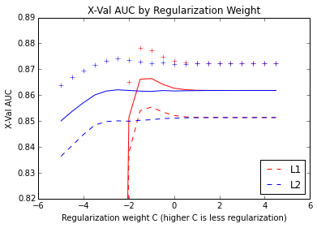
Regularization weight
We generally always want to use some model selection methodology (i.e., cross-validation) to choose the optimal regularization strength.
We can use the same method for L1 vs L2, but sometimes we choose L1 on principal alone. Its often desired to have the implicit feature selection.

